Slide 1
Log analysis
of
VOIP calls

Slide 2
Topics to be covered
Camping issues and check points.
Log analysis (adb logs, QMI Logs, SIP Logs) for below scenarios.
IMS Registration
MO VoLTE call.
VoLTE call - Local hold/Resume
VoLTE call - Remote hold and resume.
Call hang-up.
MO VT call.
Call upgrade/downgrade
Upgrade reject.

Slide 3
Camping issues and check points
In case there is any camping issue, below points needs to be checked.
QCN Issues.
SIM card detection, subscription activation.
UE band support and network rejection.

Slide 4
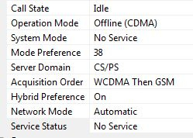
QCN Issues
➔When there is any issues with UE network latch, tester needs to check these concern.
IF UE is in Field test mode-FTM
QCN might not be loaded, load the correct qcn.
NV-00453 might not be set to 0.
Offline mode.
Issues with the loaded QCN.
Erase the QCN and load the correct QCN.
Get UE calibrated from LAB RF team.
Issue could be there with build.
Power off
A) Could be an app issue. Sync issue between modem and apps.
ONLINE mode
A) QCN is fine, device should latch on the network if everything is fine from build and network side.

Slide 5
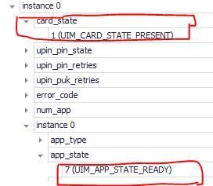
SIM card detection, subscription activation.
➔Need to check the SIM card status whether is it properly inserted and being detected.
Check SIM card ready status in adb radio logs.
CARDSTATE_ABSENT ➔ Card detection indication not reach to the apps.
CARDSTATE_PRESENT ➔ Card detection indication reach to the apps.
SubscriptionInfoUpdater: simStatus: NOT_READY
SubscriptionInfoUpdater: Ignoring simStatus: NOT_READY
Check SIM card ready status using QMI API.
Check card status from QMI API “UIM_Get_Card_Status_Req_msg”

Slide 6
UE Band support and network rejection
RACH failure
Authentication failure
Mismatch of authentication/ciphering key in SIM card and network.
Invalid IMEI.
PDN attach reject
APN Mismatch.
Missing APN.
APN issues under APN editor.
Modem profile issues.
IP type mismatch

Slide 7
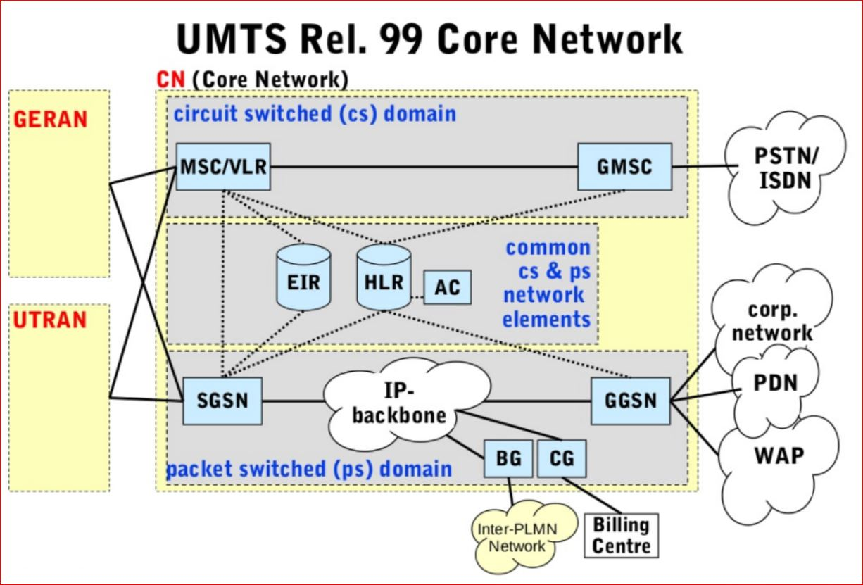
Why IMS??

Slide 8
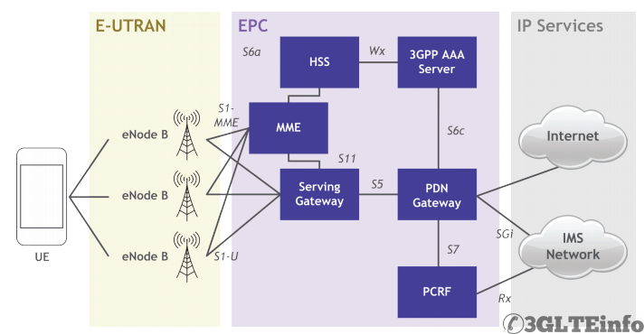
LTE and IMS Arch

Slide 9
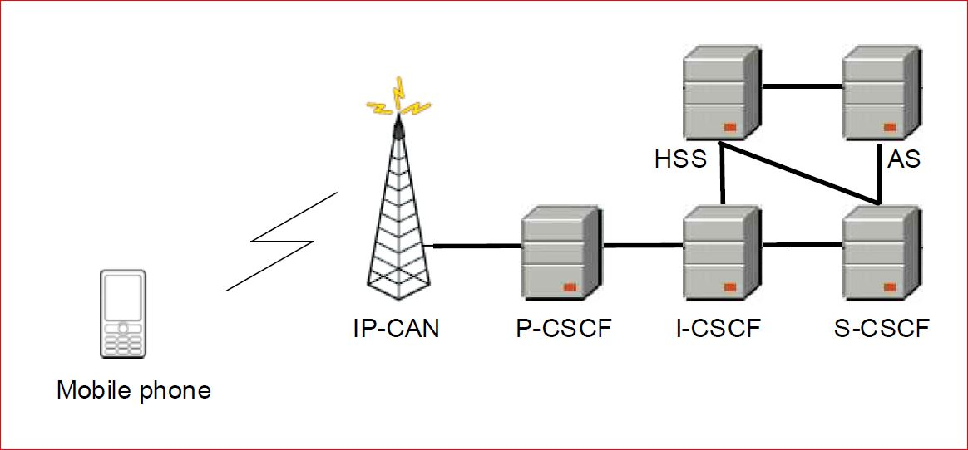
LTE and IMS Arch...

Slide 10
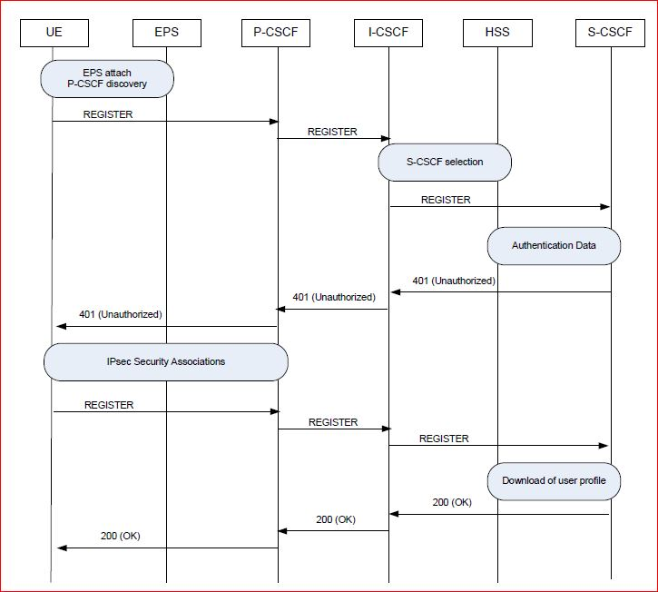
IMS Registration flow

Slide 11
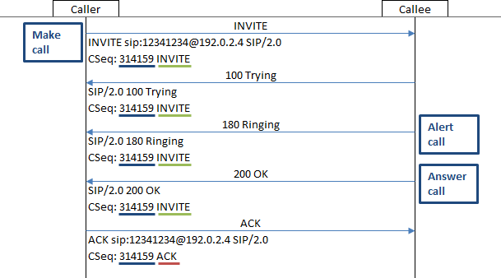
IMS VoLTE basic call flow
.

Slide 12
IMS Registration –Radio Logs
From Main Logs:
ImsSenderRxr: [0001]> REQUEST_IMS_REGISTRATION_STATE[SUB0]
ImsSenderRxr: Response data: [11, 13, 1, 0, 0, 0, 16, 2, 24, 1, 32, 0, 8, 2, 21, 0, 0, 0, 0][SUB0]
ImsSenderRxr: [0001]< REQUEST_IMS_REGISTRATION_STATE org.codeaurora.ims.ImsQmiIF$Registration@10bfccaa[SUB0]
➔REGISTERED = 1; NOT_REGISTERED = 2; REGISTERING = 3

Slide 13
IMS Registration –Radio Logs…
From Radio Logs:
Not Registered:
[3671]> RIL_REQUEST_IMS_REGISTRATION_STATE [SUB0]
[3671]< RIL_REQUEST_IMS_REGISTRATION_STATE {0, 1} [SUB0]
D RIL_ImsSms: IMS is NOT registered!
Registered:
[3797]> RIL_REQUEST_IMS_REGISTRATION_STATE [SUB0]
[3797]< RIL_REQUEST_IMS_REGISTRATION_STATE {1, 2} [SUB0]
RIL_ImsSms: IMS is registered!

Slide 14
IMS Registration: Reg State –QMI Logs
QMI API:
imsa_get_registration_status_req_msg
ims_get_service_status_req_msg
QmiImsaRegistrationStatusIndMsg {
QmiImsaRegistrationStatusIndTlvs[0] {
ImsRegistrationStatusTlv {
IMS Registered = true ➔ This value can be “true/false”
}
QmiImsaRegistrationStatusIndTlvs[1] {
NewImsRegistrationStatusTlv {
Ims Reg Status = REGISTERED ➔ This value can be “NOT_REGISTERED /REGISTERING/ REGISTERED”
}

Slide 15
IMS Registration: Service State –QMI Logs…
QmiImsaServiceStatusIndTlvs[0] {
VoIpServiceStatusTlv {
VoIP Service Status = VoIP is in full service➔ It can be “VoIP service is not available”
}
QmiImsaServiceStatusIndTlvs[1] {
VtServiceStatusTlv {
VT Service Status = 2
}

Slide 16
IMS Registration: Service State –QMI Logs…
QmiImsaServiceStatusIndTlvs[2] {
VoipRatTlv {
Voip Service Rat = WWAN ➔ It can be WLAN also for iWLAN.
}
QmiImsaServiceStatusIndTlvs[3] {
VtRatTlv {
Vt Service Rat = WWAN ➔ It can be WLAN also for iWLAN.
}

Slide 17
IMS Registration: SIP Logs
Direction = UE_TO_NETWORK
Message ID = IMS_SIP_REGISTER
Sip Message = REGISTER sip:test.3gpp.com SIP/2.0
f: <sip:890911@test.3gpp.com>;tag=549957101
t: <sip:890911@test.3gpp.com>
CSeq: 549957093 REGISTER
Max-Forwards: 70
Allow: INVITE,BYE,CANCEL,ACK,NOTIFY,UPDATE,PRACK,INFO,MESSAGE,OPTIONS

Slide 18
IMS Registration: SIP Logs…
Direction = NETWORK_TO_UE
Message ID = IMS_SIP_REGISTER
Response Code = OK (200)
SIP Call ID = 549957094_2356125800@10.252.249.146
Sip Message = SIP/2.0 200 OK
Via: SIP/2.0/UDP 10.252.249.146:5060;branch=z9hG4bK2952293469
To: <sip:890911@test.3gpp.com>;tag=b2f75f14
From: <sip:890911@test.3gpp.com>;tag=549957101
Call-ID: 549957094_2356125800@10.252.249.146
CSeq: 549957093 REGISTER
P-Associated-URI: <sip:890911@test.3gpp.com>
P-Associated-URI: <tel:890911>

Slide 19
VoLTE MO Call: adb logs
//Call Dial
ImsSenderRxr: [0004]> DIAL[SUB0]
ImsSenderRxr: [UNSL]< UNSOL_RESPONSE_CALL_STATE_CHANGED [id=1,DIALING,toa=129,norm,mo,0,voc,noevp,,cli=1,,1Call Details = 0 3.......
ImsSenderRxr: [0004]< DIAL [SUB0]
ImsSenderRxr: [UNSL]< UNSOL_RESPONSE_CALL_STATE_CHANGED [id=1,DIALING,toa=129,norm,mo,0,voc,noevp,,cli=1,,1Call Details = 0 3.......
//Call Alert/Ringing at remote end
ImsSenderRxr: [UNSL]< UNSOL_RINGBACK_TONE {1}[SUB0]
ImsSenderRxr: [UNSL]< UNSOL_RESPONSE_CALL_STATE_CHANGED [id=1,ALERTING,toa=129,norm,mo,0,voc,noevp,,cli=1,,1Call Details = 0 3.......
//Call Answered at remote end:
ImsSenderRxr: [UNSL]< UNSOL_RESPONSE_CALL_STATE_CHANGED [id=1,ACTIVE,toa=129,norm,mo,0,voc,noevp,,cli=1,,1Call Details = 0 2.......

Slide 20
VoLTE MO Call: QMI logs
//Being Dial----
2016 Feb 5 14:34:00.551 [AE] 0x138E QMI Link 1 RX PDU
QmiType = VOICE
SduCtlFlags = REQ
MsgType = QMI_VOICE_DIAL_CALL_MSG
Tlvs[0] {
Calling Number Tlv {
calling_number = { 56, 57, 53, 50, 49, 49 }
}
Tlvs[1] {
Call Type Tlv {
call_type = VOICE
}
Tlvs[2] {
Service Type {
service_type = VOICE_DIAL_CALL_SRV_TYPE_AUTOMATIC ➔If it is automatic means call being dialed on PS domain else it will be CS domain.
}

Slide 21
VoLTE MO Call: QMI logs….
//Call is in progress
MsgType = QMI_VOICE_ALL_CALL_STATUS_IND
CallInfo Tlv {
CallState = CC_IN_PROGRESS
CallType = VOICE
Direction = MO: Mobile Originated Call
Mode = UNKNOWN
}
Tlvs[1] {
RemotePartyNumber Tlv {
NumberPI = PRESENTATION ALLOWED
NumberLen = 6
Number = 895211
}

Slide 22
VoLTE MO Call: QMI logs….
MsgType = QMI_VOICE_ALL_CALL_STATUS_IND
Service_Voc_V2 {
Tlvs[0] {
CallInfo Tlv {
CallState = ORIGINATION ➔Can be CC_IN_PROGRESS, CONVERSATION also
CallType = VOICE_IP
Direction = MO: Mobile Originated Call
Mode = LTE ➔ can be WLAN also in case of iWLAN call.
}

Slide 23
VoLTE MO Call: SIP logs….
//Call dialed out:
Direction = UE_TO_NETWORK
SDP Presence = 1
Message ID = IMS_SIP_INVITE
Sip Message = INVITE tel:895211; SIP/2.0
f: "890911" <sip:890911@test.3gpp.com>;tag=551707231
t: <tel:895211 >
Max-Forwards: 70
Route: <sip:10.44.0.102:5060;lr>
Allow: INVITE,ACK,CANCEL,BYE,UPDATE,PRACK,MESSAGE,REFER,NOTIFY,INFO
k: 100rel,replaces,histinfo
P-Early-Media: supported
m=audio 50010 RTP/AVP 99 97 105 96
a=sendrecv ➔ Other possible values are: SendOnly (local hold), ReceiveOnly(Remote hold), Inactive(Hold by local and remote both)

Slide 24
VoLTE MO Call: SIP logs….
//Trying
Direction = NETWORK_TO_UE
SDP Presence = 0
Message ID = IMS_SIP_INVITE
Response Code = TRYING (100)
SIP Call ID = 551707220_2356419288@10.252.249.146
Sip Message = SIP/2.0 100 Trying
//Ringing
Direction = NETWORK_TO_UE
SDP Presence = 0
Message ID = IMS_SIP_INVITE
Response Code = RINGING (180)
SIP Call ID = 551707220_2356419288@10.252.249.146
Sip Message = SIP/2.0 180 Ringing

Slide 25
VoLTE MO Call: SIP logs….
//Call accepted by remote party:
Direction = NETWORK_TO_UE
SDP Presence = 1
SIP Call ID Length = 36
SIP Message Length = 866
Message ID = IMS_SIP_INVITE
Response Code = OK (200)
//SDP- Session Description protocol.
m=audio 50010 RTP/AVP 99 105
a=sendrecv

Slide 26
Local Call hold/Resume: Adb logs….
ImsSenderRxr: [0005]> REQUEST_HOLD[SUB0]
ImsSenderRxr: [0005]< REQUEST_HOLD [SUB0]
ImsSenderRxr: [UNSL]< UNSOL_RESPONSE_CALL_STATE_CHANGED [id=1,HOLDING…………………
ImsSenderRxr: [0006]> REQUEST_RESUME[SUB0]
ImsSenderRxr: [UNSL]< UNSOL_RESPONSE_CALL_STATE_CHANGED [id=1,ACTIVE……..
ImsSenderRxr: [0006]< REQUEST_RESUME [SUB0]

Slide 27
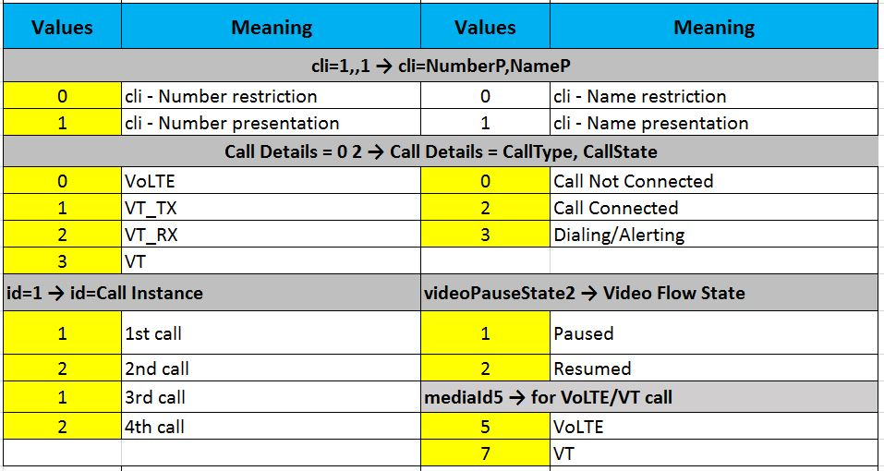
Local Call hold/Resume: Adb logs….
ImsSenderRxr: [UNSL]< UNSOL_RESPONSE_CALL_STATE_CHANGED [id=1,HOLDING,toa=129,norm,mo,0,voc,noevp,,cli=1,,1Call Details = 0 2 Codec=AMR_WB callSubState 0 = videoPauseState2 mediaId5 Local Ability isValid = true type = 0 status = 2 accTechStatus mode 14

Slide 28
Local Call hold/Resume: QMI logs….
//QMI log print for Hold Call
Instance[0] {
CallId = 1
CallState = HOLD
CallType = VOICE_IP
Direction = MO: Mobile Originated Call
Mode = LTE
}
//QMI log print for Resume Call
Instance[0] {
CallId = 1
CallState = CONVERSATION
CallType = VOICE_IP
Direction = MO: Mobile Originated Call
Mode = LTE
}

Slide 29
Remote Call hold/Resume: Adb logs….
//MT call hold
ImsSenderRxr: [UNSL]< UNSOL_SUPP_SVC_NOTIFICATION org.codeaurora.ims.ImsQmiIF$SuppSvcNotification@1738cc5[SUB0]
ImsServiceClassTracker: handleSuppSvcUnsol suppNotification= { notificationType=1, code=2, index=0, type=0, number=, history=null }
//MT call Resume
ImsSenderRxr: [UNSL]< UNSOL_SUPP_SVC_NOTIFICATION org.codeaurora.ims.ImsQmiIF$SuppSvcNotification@4af89e6[SUB0]
ImsServiceClassTracker: handleSuppSvcUnsol suppNotification= { notificationType=1, code=3, index=0, type=0, number=, history=null }
Where-
notificationType=1 ➔ MT Call, 0 ➔ MO Call.
code=2 => Hold, 3 ➔ Resume

Slide 30
Remote Call hold/Resume: QMI logs….
//Call Hold
QmiType = VOICE
SduCtlFlags = IND
MsgType = QMI_VOICE_SUPS_NOTIFICATION_IND
Tlv[0] {
Notification Info Tlv {
Call Id = 1
VoiceSupsNotificationInf_NotificationType Tlv = CALL_IS_ON_HOLD
}
//Call Retrieved
QmiType = VOICE
SduCtlFlags = IND
MsgType = QMI_VOICE_SUPS_NOTIFICATION_IND
Tlv[0] {
Notification Info Tlv {
Call Id = 1
VoiceSupsNotificationInf_NotificationType Tlv = CALL_IS_RETRIEVED
}

Slide 31
Call hang-up from local end: adb logs
ImsSenderRxr: [0007]> HANGUP[SUB0]
ImsSenderRxr: [0007]< HANGUP [SUB0]
ImsSenderRxr: [UNSL]< UNSOL_RESPONSE_CALL_STATE_CHANGED [id=1,END,toa=129,norm,mo,0,voc,noevp,,cli=1,, Call Details = 0 2

Slide 32
Call hang-up from local end: QMI logs
2016 Feb 5 14:39:07.150 [68] 0x138E QMI Link 1 RX PDU
SduCtlFlags = REQ
MsgType = QMI_VOICE_END_CALL_MSG
Tlvs[0] {
Call ID Tlv {
Call ID = 1
}
2016 Feb 5 14:39:07.152 [E3] 0x138F QMI Link 1 TX PDU
SduCtlFlags = RES
MsgType = QMI_VOICE_END_CALL_MSG
ResultCodeTlv {
ResultCode = QMI_RESULT_SUCCESS
ErrorCode = QMI_ERROR_NONE
}

Slide 33
Call hang-up from local end: QMI logs
2016 Feb 5 14:39:07.156 [B6] 0x138F QMI Link 1 TX PDU
QmiType = VOICE
SduCtlFlags = IND
MsgType = QMI_VOICE_ALL_CALL_STATUS_IND
Tlvs[0] {
Instance[0] {
CallId = 1
CallState = DISCONNECTING ➔ After call end it will be "END"
CallType = VOICE_IP
Direction = MO: Mobile Originated Call
Mode = LTE
}

Slide 34
Call hang-up from local end: SIP logs
2016 Feb 5 14:39:07.168 [85] 0x156E IMS SIP Message
Direction = UE_TO_NETWORK
SDP Presence = 0
Message ID = IMS_SIP_BYE
t: <tel:895211;phone-context=vzwims.com>;tag=ab001d35
f: "890911"<sip:890911@test.3gpp.com>;tag=551707231
2016 Feb 5 14:39:07.281 [C4] 0x156E IMS SIP Message
Direction = NETWORK_TO_UE
SDP Presence = 0
Message ID = IMS_SIP_BYE
Response Code = OK (200)
Sip Message = SIP/2.0 200 OK
To: <tel:895211;phone-context=vzwims.com>;tag=ab001d35
From: "890911"<sip:890911@test.3gpp.com>;tag=551707231

Slide 35
MO VT Call: adb logs
ImsSenderRxr: [0009]> DIAL[SUB0]
ImsSenderRxr: [UNSL]< UNSOL_RESPONSE_CALL_STATE_CHANGED [id=1,DIALING,toa=129,norm,mo,0,voc,noevp,,cli=1,,1Call Details = 3 2
ImsSenderRxr: [0009]< DIAL [SUB0]
ImsSenderRxr: [UNSL]< UNSOL_RINGBACK_TONE {1}[SUB0]
ImsSenderRxr: [UNSL]< UNSOL_RESPONSE_CALL_STATE_CHANGED [id=1,ALERTING,toa=129,norm,mo,0,voc,noevp,,cli=1,,1Call Details = 3 2
ImsSenderRxr: [UNSL]< UNSOL_RESPONSE_CALL_STATE_CHANGED [id=1,ACTIVE,toa=129,norm,mo,0,voc,noevp,,cli=1,,1Call Details = 3 2 C

Slide 36
MO VT Call: QMI logs
2016 Feb 5 14:45:38.314 [7B] 0x138E QMI Link 1 RX PDU
QmiType = VOICE
SduCtlFlags = REQ
MsgType = QMI_VOICE_DIAL_CALL_MSG
MsgLength = 42
Service_Voc_V2 {
Tlvs[0] {
Calling Number Tlv {
calling_number = { 56, 57, 53, 50, 49, 49 }
}
Tlvs[1] {
Call Type Tlv {
call_type = VT
}
Tlvs[2] {
Service Type {
service_type = VOICE_DIAL_CALL_SRV_TYPE_AUTOMATIC
}
Tlvs[3] {
AudioAttributeForVtOrVoipCAllTlv {
Audio Attrib = 3
}
Tlvs[4] {
VideoAttributeForVtOrVoipCAllTlv {
Video Attrib = 3
}

Slide 37
MO VT Call: SIP logs
2016 Feb 5 14:45:38.484 [6A] 0x156E IMS SIP Message
Direction = UE_TO_NETWORK
SDP Presence = 1
Message ID = IMS_SIP_INVITE
Response Code = INFORMAL_RESPONSE (0)
Sip Message = INVITE tel:895211;phone-context=vzwims.com SIP/2.0
f: "890911" <sip:890911@test.3gpp.com>;tag=552405039
t: <tel:895211;phone-context=vzwims.com>
Max-Forwards: 70
v=0
m=audio 50010 RTP/AVP 99 97 105 96
a=rtpmap:99 AMR-WB/16000/1
a=sendrecv
m=video 60010 RTP/AVPF 114 113
a=rtpmap:114 H264/90000
a=sendrecv

Slide 38
VT➔VoLTE➔VT call transition adb Logs…
//VT to VoLTE downgrade:
ImsSenderRxr: modifyCallInitiate callModify= 1 0 2 callSubState 0 videoPauseState2 mediaId-1 Local Ability Peer Ability Cause code 0 0[SUB0]
ImsSenderRxr: [0010]> MODIFY_CALL_INITIATE[SUB0]
ImsSenderRxr: [0010]< MODIFY_CALL_INITIATE [SUB0]
ImsSenderRxr: [UNSL]< UNSOL_RESPONSE_CALL_STATE_CHANGED [id=1,ACTIVE,toa=129,norm,mo,0,voc,noevp,,cli=1,,1Call Details = 0 2
//VoLTE to VT upgrade:
ImsSenderRxr: modifyCallInitiate callModify= 1 3 2 callSubState 0 videoPauseState2 mediaId-1 Local Ability Peer Ability Cause code 0 0[SUB0]
ImsSenderRxr: [0011]> MODIFY_CALL_INITIATE[SUB0]
ImsSenderRxr: [0011]< MODIFY_CALL_INITIATE [SUB0]
ImsSenderRxr: [UNSL]< UNSOL_RESPONSE_CALL_STATE_CHANGED [id=1,ACTIVE,toa=129,norm,mo,0,voc,noevp,,cli=1,,1Call Details = 3 2

Slide 39
VT➔VoLTE call transition QMI Logs…
2016 Feb 5 14:47:25.917 [BC] 0x138E QMI Link 1 RX PDU
QmiType = VOICE
SduCtlFlags = REQ
MsgType = QMI_VOICE_MANAGE_IP_CALLS
Service_Voc_V2 {
ManageIpCallsInfoTlv {
sups_type = MODIFY_CALL
AudioAttributeTForVtOrVoipCallTlv {
Audio Attrib = 3
Video Attrib = 0
}

Slide 40
VT➔VoLTE➔VT call transition SIP Logs…
m=audio 50010 RTP/AVP 99 105
b=AS:41
b=RS:600
b=RR:2000
a=rtpmap:99 AMR-WB/16000/1
a=sendrecv
a=maxptime:240
a=ptime:20
m=video 0 RTP/AVPF 114
a=inactive
a=extmap:2 urn:3gpp:video-orientation

Slide 41
VoLTE➔VT call transition QMI Logs…
2016 Feb 5 14:48:59.785 [60] 0x138E QMI Link 1 RX PDU
SduCtlFlags = REQ
MsgType = QMI_VOICE_MANAGE_IP_CALLS
Service_Voc_V2 {
ManageIpCallsInfoTlv {
sups_type = MODIFY_CALL
CallTypeTlv {
Call Type = VT
AudioAttributeTForVtOrVoipCallTlv {
Audio Attrib = 3
VidioAttributeTForVtOrVoipCallTlv {
Video Attrib = 3
}

Slide 42
VoLTE➔VT call transition QMI Logs…
2016 Feb 5 14:49:07.978 [2B] 0x138F QMI Link 1 TX PDU
SduCtlFlags = RSP
MsgType = QMI_VOICE_MANAGE_IP_CALLS
Tlvs[0] {
ResultCode {
QmiResult = QMI_RESULT_SUCCESS
QmiError = QMI_ERROR_NONE
}
Tlvs[1] {
CallModifiedCauseTlv {
call_modified_cause = VOICE_CALL_MODIFIED_CAUSE_UPGRADE_DUE_TO_LOCAL_REQ
}

Slide 43
VoLTE➔VT call transition QMI Logs…
2016 Feb 5 14:49:07.978 [2B] 0x138F QMI Link 1 TX PDU
SduCtlFlags = IND
MsgType = QMI_VOICE_MODIFIED_IND
QmiVoiceModifiedIndTlvs[1] {
CallTypeTlv {
Call Type = VT
}
QmiVoiceModifiedIndTlvs[2] {
AudioAttributeForVtOrVoipCAllTlv {
Audio Attrib = 3
}
QmiVoiceModifiedIndTlvs[3] {
VideoAttributeForVtOrVoipCAllTlv {
Video Attrib = 3
}

Slide 44
VoLTE➔VT call transition SIP Logs…
2016 Feb 5 14:48:59.819 [1A] 0x156E IMS SIP Message -- IMS_SIP_INVITE/INFORMAL_RESPONSE
Direction = UE_TO_NETWORK
Message ID = IMS_SIP_INVITE
Response Code = INFORMAL_RESPONSE (0)
CM Call ID = 7
Sip Message = INVITE sip:IR92TransferB2B_00000019@ice.qualcomm.com SIP/2.0
f: "890911"<sip:890911@test.3gpp.com>;tag=552405039
t: <tel:895211;phone-context=vzwims.com>;tag=bdb46a06
CSeq: 552405029 INVITE
m=audio 50010 RTP/AVP 99 105
a=sendrecv
m=video 60010 RTP/AVPF 114
a=sendrecv

Slide 45
VoLTE➔VT call transition SIP Logs…
2016 Feb 5 14:49:07.941 [DB] 0x156E IMS SIP Message -- IMS_SIP_INVITE/OK
Direction = NETWORK_TO_UE
Message ID = IMS_SIP_INVITE
Response Code = OK (200)
CM Call ID = 7
Sip Message = SIP/2.0 200 OK
m=audio 50010 RTP/AVP 99 105
a=rtpmap:99 AMR-WB/16000/1
a=sendrecv
m=video 60010 RTP/AVPF 114
a=rtpmap:114 H264/90000
a=sendrecv

Slide 46
VoLTE➔VT call upgrade reject by remote: adb logs
ImsSenderRxr: modifyCallInitiate callModify= 1 3 2 callSubState 0 videoPauseState2 mediaId-1 Local Ability Peer Ability Cause code 0 0[SUB0]
ImsSenderRxr: [0017]> MODIFY_CALL_INITIATE[SUB0]
ImsSenderRxr: [0017]< MODIFY_CALL_INITIATE error: 28

Slide 47
VoLTE➔VT call upgrade reject by remote: QMI logs
2016 Feb 5 14:52:29.051 [70] 0x138F QMI Link 1 TX PDU
QmiType = VOICE
SduCtlFlags = RSP
MsgType = QMI_VOICE_MANAGE_IP_CALLS
Tlvs[0] {
ResultCode {
QmiResult = QMI_RESULT_FAILURE
QmiError = QMI_ERR_SUPS_FAILURE_CAUSE
}
Tlvs[1] {
Type = 17
Length = 2
FailureCauseTlv {
Failure Cause = QMI_FAILURE_CAUSE_UPGRADE_DOWNGRADE_REJ
}

Slide 48
VoLTE➔VT call upgrade reject by remote: SIP logs
2016 Feb 5 14:52:29.022 [52] 0x156E IMS SIP Message
Direction = NETWORK_TO_UE
SDP Presence = 1
Message ID = IMS_SIP_INVITE
Response Code = OK (200)
Sip Message = SIP/2.0 200 OK
Via: SIP/2.0/UDP 10.252.249.146:5060;branch=z9hG4bK672752228
v=0
m=audio 50010 RTP/AVP 99 105
a=rtpmap:99 AMR-WB/16000/1
a=sendrecv
m=video 0 RTP/AVPF 114
a=inactive

Slide 49
Cheers!! ☺

